Slide 1

Project Title - Crop Production Analysis
Tanishq Borse

Slide 2

PROBLEM STATEMENT
Power BI tool used for efficient and comprehensive crop production analysis.

Slide 3
Project Description
The process of collecting and analyzing crop production data in agriculture is outdated, error prone and lacks the depth necessary to make effective decisions This hinders efforts to improve yields greater, reduce costs and bridge the gap in food security. Adopting modern solutions like Power BI is essential to addressing these challenges. Power BI provides advanced tools for streamlined data analysis, empowers stakeholders to make informed decisions and optimizes farming efforts using a visualization.

Slide 4

WHO ARE THE END USERS?
Farmers and agricultural workers
Agronomists and agricultural advisors
Agricultural policymakers and government agencies

Slide 5

Technology Used
The key technology covered in the given problem statement is Power BI (Business Intelligence). Power BI is a business analytics tool developed by Microsoft that allows users to visualize and analyze data from a variety of sources. It offers features such as data integration, interactive dashboards, advanced analytics and reporting capabilities.

Slide 6
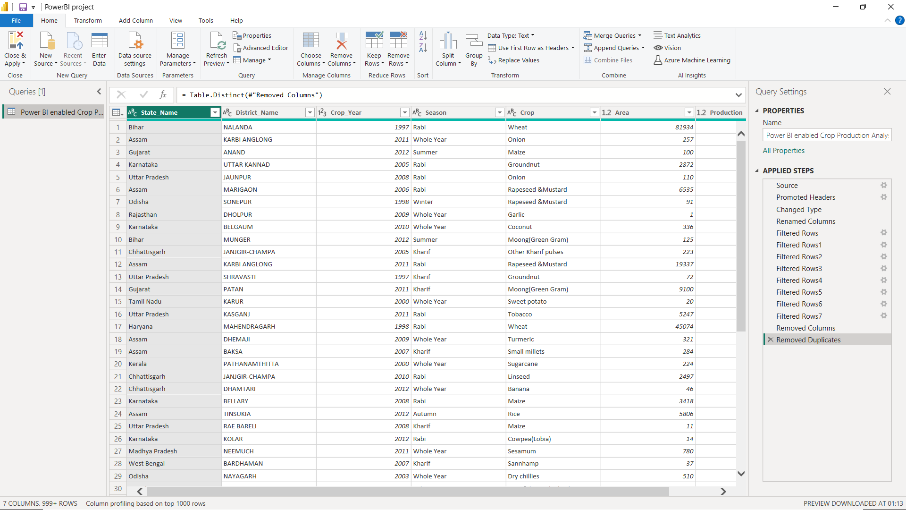
RESULTS
Data Cleaning -
Demo Link

Slide 7
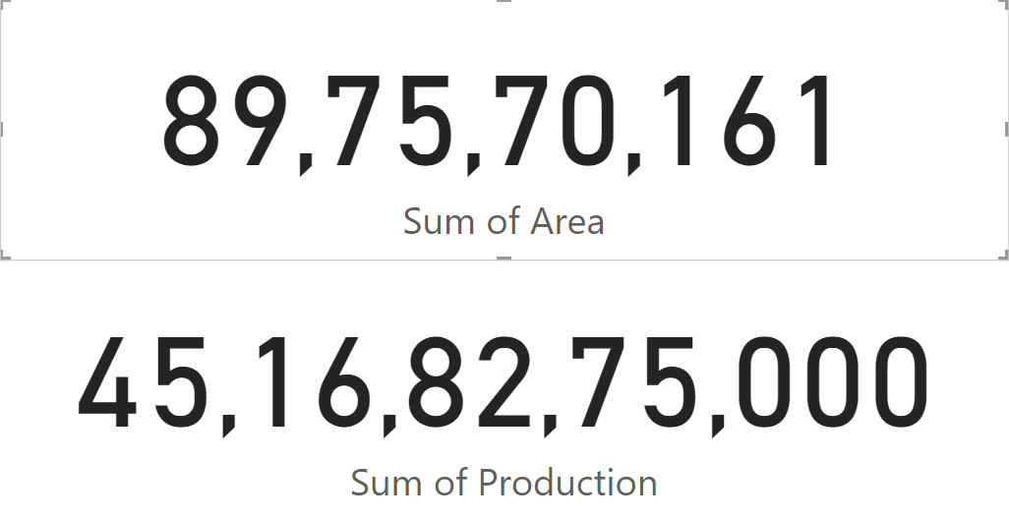
RESULTS
Sum of Area and Sum of Production -
Demo Link

Slide 8
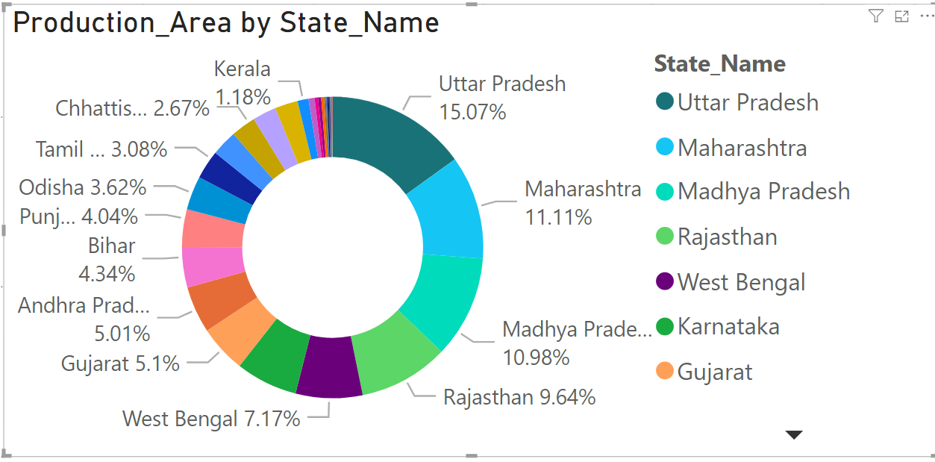
RESULTS
Production per State -
Demo Link

Slide 9
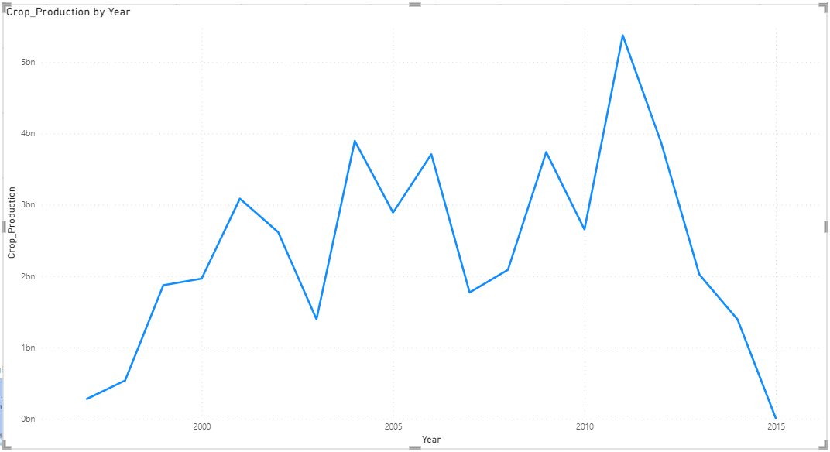
RESULTS
Year wise production -
Demo Link

Slide 10
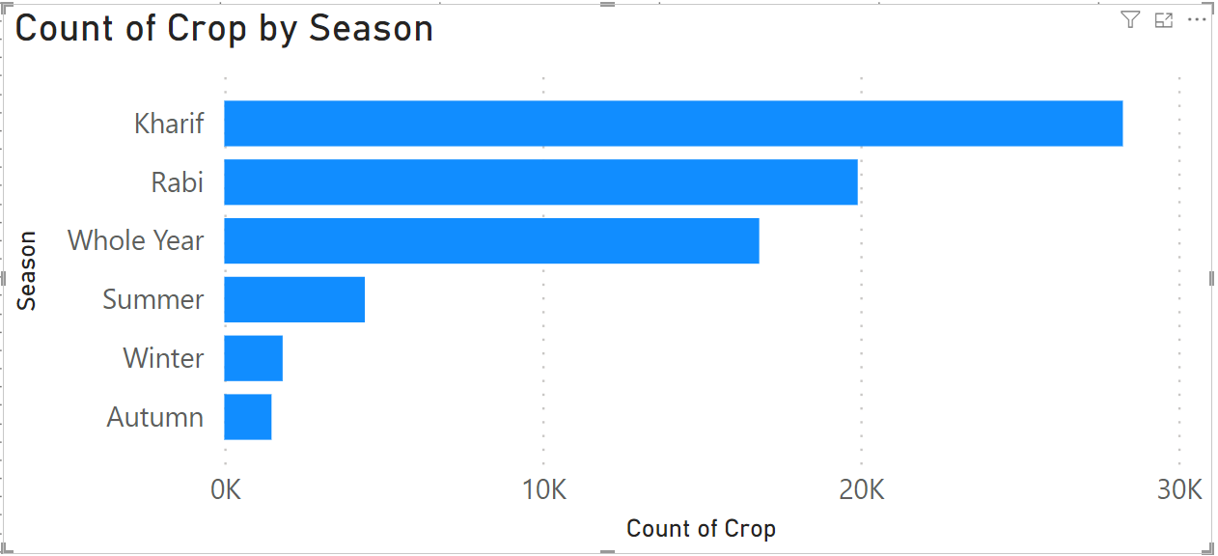
RESULTS
Season Wise count of crop -
Demo Link

Slide 11
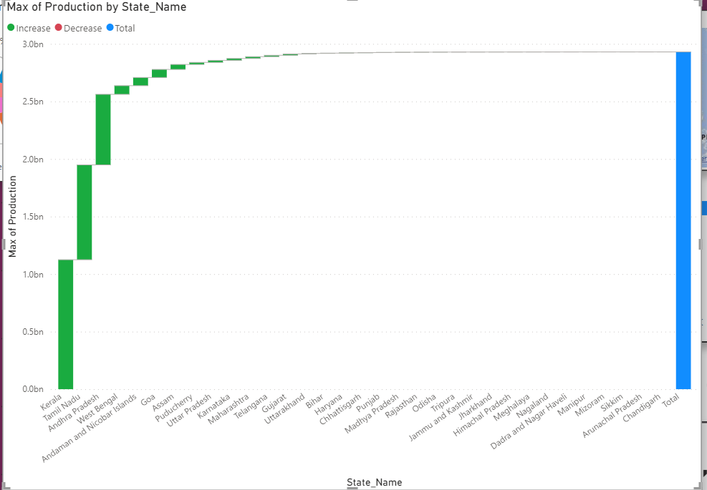
RESULTS
Maximum production per State -
Demo Link

Slide 12
Thank you
.
.

